Slide 1
Analysis of Google Play Store Data

Slide 2
Overview and problem statement
Which apps are most reviewed? Out of those, which three have the highest ratings?
How do the apps vary by rating, pricing etc.,?
Do people review paid apps in the same way they review free apps?
Analysis to understand user reviews and what they convey about opinions of users of these apps
Intended audience - Developers, product management and marketing teams, investors etc.,

Slide 3
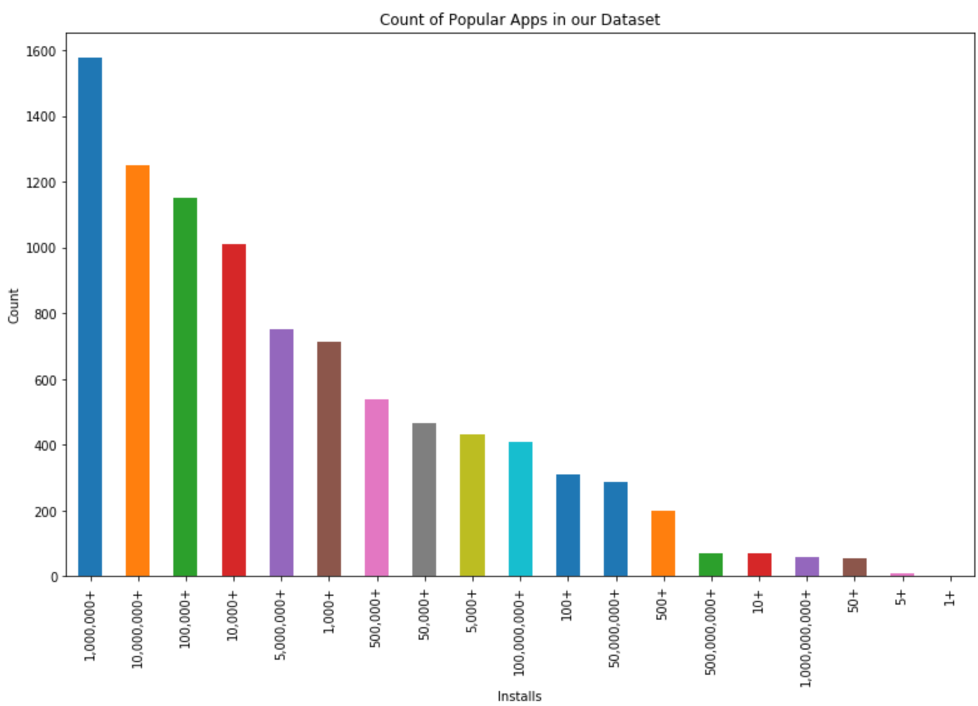
Popular Apps
Notes:
Moving from research question to some kind of hypothesis -- you want to use logic, theory and prior empirical evidence to move toward some hypotheses you can test. This is why domain expertise cannot be overlooked among data scientists.

Slide 4
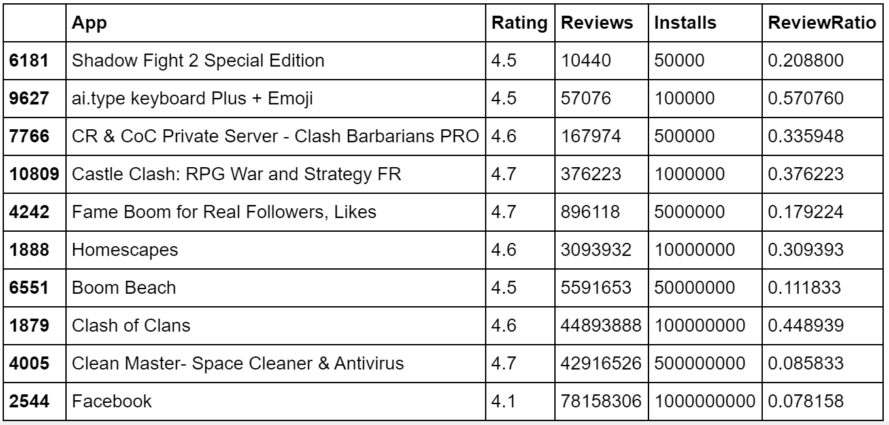
Most Reviewed Apps
Notes:
Moving from research question to some kind of hypothesis -- you want to use logic, theory and prior empirical evidence to move toward some hypotheses you can test. This is why domain expertise cannot be overlooked among data scientists.

Slide 5
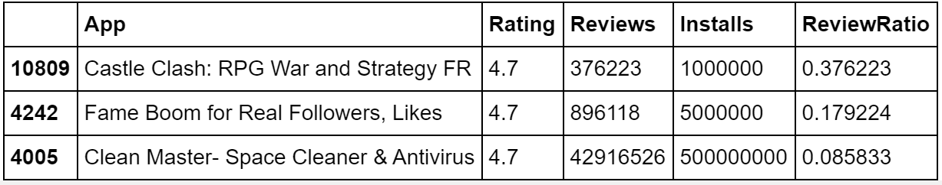
Highest Rated Apps
Notes:
Moving from research question to some kind of hypothesis -- you want to use logic, theory and prior empirical evidence to move toward some hypotheses you can test. This is why domain expertise cannot be overlooked among data scientists.

Slide 6
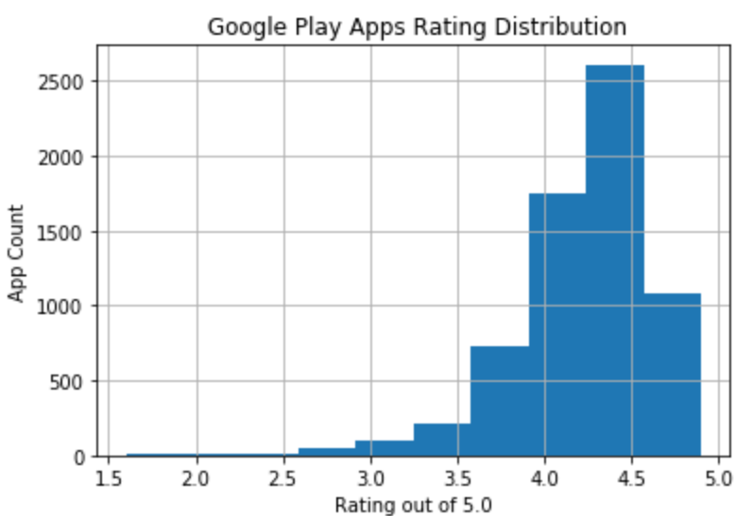
Apps by Rating:
Over 2,500 of the apps in the top 10 bins have a rating of over 4.2 to a nudge over 4.5, maybe 4.6.
And almost 1000 apps have been rated higher than that.
Most reviewed apps, have ratings of 4.7
Further analysis, we have 129 apps with ratings higher than 4.7
Notes:
A statistical method is not a story, but we can tell a story from the statistics. For example, using confidence intervals we can put into dollars what we think would happen if we make some business move, given the data that we have.
The words “t-test,” “normality,” “independent samples” etc did not come up at all in this explanation! Although someone who does know about this stuff can still have confidence in the results with the way you have laid out the story and the quantifiable results.

Slide 7
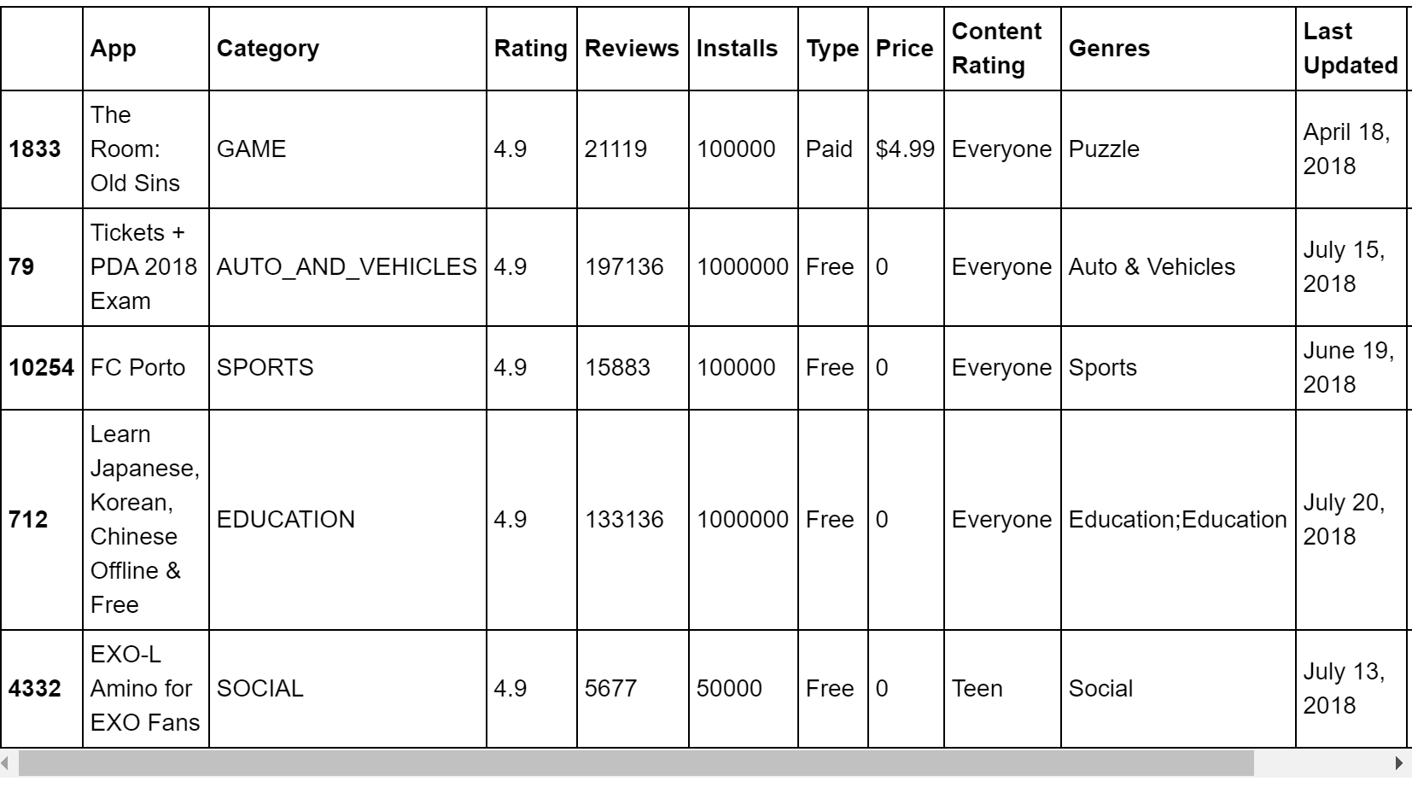
Top 5 apps by rating
Notes:
A statistical method is not a story, but we can tell a story from the statistics. For example, using confidence intervals we can put into dollars what we think would happen if we make some business move, given the data that we have.
The words “t-test,” “normality,” “independent samples” etc did not come up at all in this explanation! Although someone who does know about this stuff can still have confidence in the results with the way you have laid out the story and the quantifiable results.

Slide 8
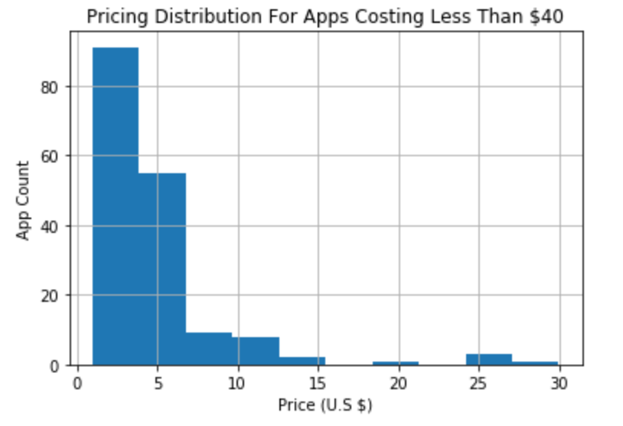
Apps by Pricing
Most apps cost less than $5 or even $3.
Amount of apps that cost more than that significantly decrease as we go up through the pricing.
Human creativity, ability to code will lower the entry barriers for more competition.
Pricing an app significantly higher than the market will certainly require significant, sustainable competitive advantage.
Notes:
A statistical method is not a story, but we can tell a story from the statistics. For example, using confidence intervals we can put into dollars what we think would happen if we make some business move, given the data that we have.
The words “t-test,” “normality,” “independent samples” etc did not come up at all in this explanation! Although someone who does know about this stuff can still have confidence in the results with the way you have laid out the story and the quantifiable results.

Slide 9
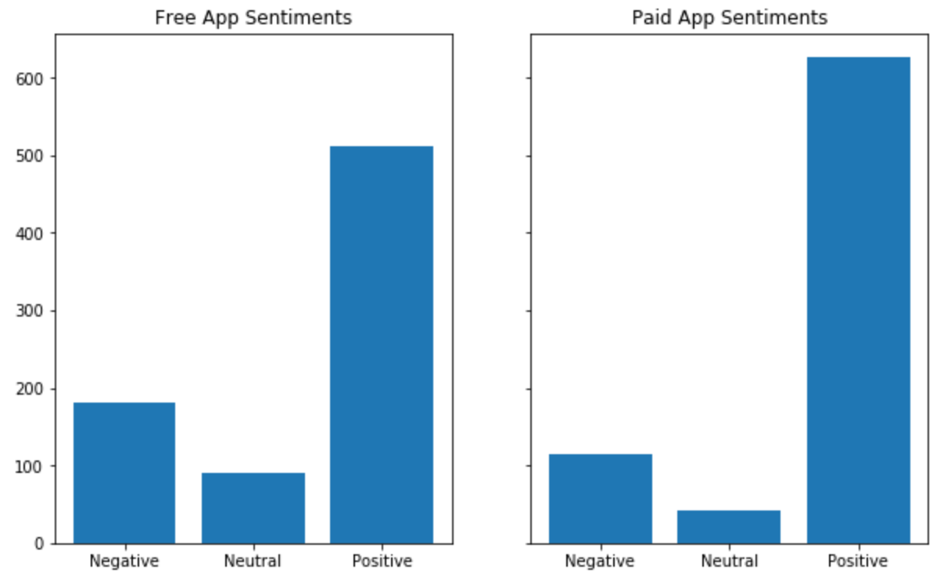
People reviews – Free Vs. Paid Apps
After we have taken a sample free apps of equal size to paid apps, the plots shows difference in positive sentiments is distributed.
Free apps have more negative and neutral reviews, indicating higher variance of sentiments for free apps.
Notes:
A statistical method is not a story, but we can tell a story from the statistics. For example, using confidence intervals we can put into dollars what we think would happen if we make some business move, given the data that we have.
The words “t-test,” “normality,” “independent samples” etc did not come up at all in this explanation! Although someone who does know about this stuff can still have confidence in the results with the way you have laid out the story and the quantifiable results.

Slide 10
Key Observations
Based on the review ratio, a positive correlation of about 0.64 confirms that reviews do increase with the amount of installs, but not concurrently.
After we have taken a sample of free apps of equal size to paid apps, it’s clear that free apps have more negative and neutral reviews, indicating higher variance of sentiments for free apps.
Notes:
https://unsplash.com/photos/OX_en7CXMj4
Then we want to move to recommendations, what is the call to action? What should your audience do now that they know what you have told them?

Slide 11
Recommendations
Reviewing this analysis will help developers to categorize their development based on ratings, price, target audience, geography, age etc.,
It will also help the product management/marketing team within a company to take users inputs and make it more user friendly, content driven etc., And this in turn will help find the right audience and improve the bottom line.
Actionable insights can be drawn for developers to work on and capture the Android market!
Notes:
https://unsplash.com/photos/OX_en7CXMj4
Then we want to move to recommendations, what is the call to action? What should your audience do now that they know what you have told them?

Slide 12
Conclusion
For a broader analysis, the dataset could've contained some of key information like user behaviors, and their browsing / buying habits , fav. contents etc.,
Sample could have from various geographical locations and this would have helped us to understand what's popular where and why?
Play store apps data has enormous potential to drive app making businesses to success.
Notes:
https://unsplash.com/photos/OX_en7CXMj4
Then we want to move to recommendations, what is the call to action? What should your audience do now that they know what you have told them?

Slide 13
Questions?

Slide 14
Thank You

